Slide 1
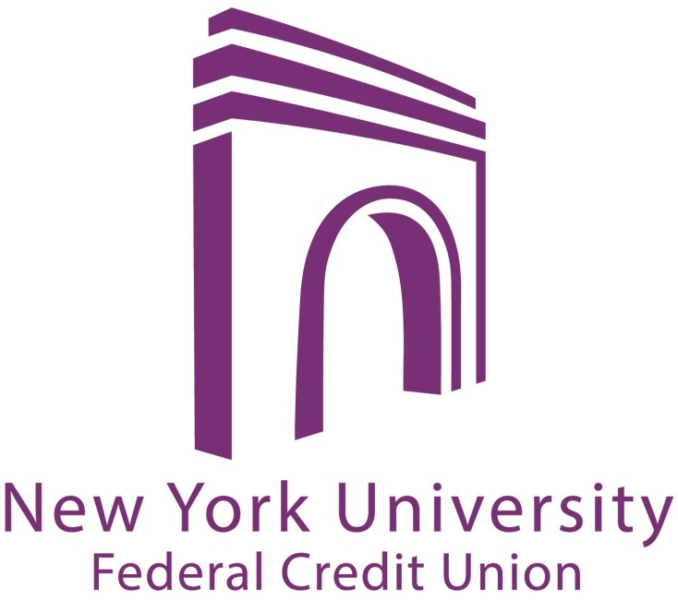
First Time Homebuyer:
Your Roadmap and
Your Options
Fall 2012
Mira Ness

Slide 2
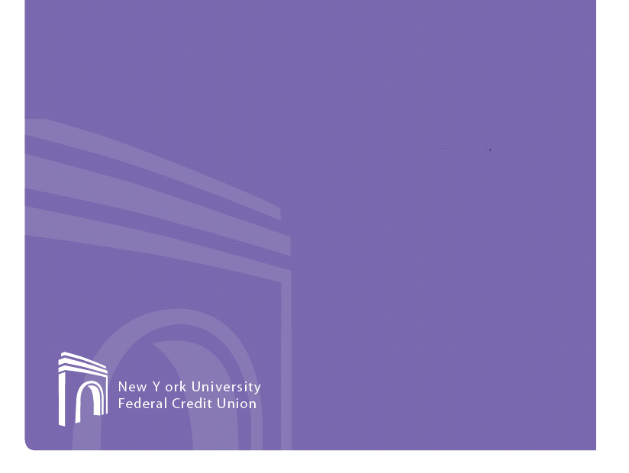
Today’s Roadmap
Early preparation
Overview of the home buying process
How much down payment?
Private mortgage insurance
Low down payment mortgage options
First Time Home Buyers program
HomeReady program
Doctors program
Questions & Answers

Slide 3
Early Preparation
Assemble your team
Lender
Agent
Attorney
Budget and credit review
Define your goals
Location
Type of home (single family, condo or co-op)
Price
Timing

Slide 4

Home Buying Process
Consult with your Mortgage Representative
Pre-Qualification: a preliminary determination of what you can afford and establishes an appropriate price range
Pre-Approval: the next step before finding a property and involves a formal application with review of your income, assets and credit profile

Slide 5
Home Buying Process (cont’d)
Choose an attorney
Select property and make an offer
The contract process
Sellers’ attorney drafts contract for review by all parties
Buyers’ attorney negotiates, reviews building documents
Buyer issues contract deposit
Buyer submits contract to lender
Property title history reviewed
Submit board package (co-ops and some condos)
Clear lender’s underwriting conditions and schedule closing

Slide 6
What is a down payment?
A cash payment that is a percentage of the full purchase price of a home
Usually equal to 5% to 30% of the total value of the home, then your mortgage loan covers the rest of the amount

Slide 7
The value of a low down payment mortgage
You don’t need to save as much cash, potentially allowing you to purchase your home sooner
Potentially keep more of your savings in case an unexpected financial need arises (car trouble, medical expenses, etc.)
Use for funds to purchase other items related to your home purchase (furniture, remodeling, etc.)
Please note that co-ops – which make up about 65% of the New York City market – may have strict rules on the amount required for your down payment.

Slide 8
Most common way of lowering your down payment
Private mortgage insurance (PMI)
Protects the lending institution in case of default payments, making them more willing to offer a low down payment mortgage
May be difficult to obtain if you are looking to purchase a co-op. PMI is typically only available for single family and condominiums.
Not available for foreign nationals, non-occupant co-borrowers, or if using the property as an investment property

Slide 9
Benefits of private mortgage insurance (PMI)
Eligible borrowers may receive tax deductible premiums. (Please consult with your tax advisor)
The premium can be added to your mortgage payment so you don’t have to make a separate payment.
You only have to keep your PMI until your outstanding loan balance drops to a certain percentage of the home’s original value:
At 80% you can request your policy to be cancelled
At 78% your lender is required to automatically cancel your policy

Slide 10
Low down payment mortgage options
NYUFCU offers the following low down payment mortgage options for qualified members:
First Time Home Buyers program
HomeReady loans
Doctors program

Slide 11
First Time Home Buyer Club program
ELIGIBILITY REQUIREMENTS FOR FIRST HOME CLUB HOUSEHOLDS
In order to be approved as a qualified household, the household must:
Meet the definition of a First-Time Homebuyer.
Be a resident in NY or NJ district at time of enrollment.
Plan to purchase an eligible property type within NJ or NY, namely:
1-4 family home
Condominium
Cooperative
Not be a fully matriculated student within six (6) months of enrollment.
Meet the income guidelines at the time of enrollment with a total household income of 80% or less of the area median income for current place of residence, adjusted for family size, as determined under 26 U.S.C. 124(f), Mortgage Revenue Bonds, (“MRB”),as published by a State agency or instrumentality. NY Income Guidelines NJ Income Guidelines
Open a dedicated savings account- First Time Home Buyer Club account- at the NYU FCU and agree to save systematically on a monthly basis for a minimum of 10 months to achieve an “Equity Goal” as determined by the household and NYUFCU. Any withdrawals from the dedicated savings account must be directly related to the home purchase under the FHC Program. The maximum time to close on property is within 24 months of enrollment.
Agree to completion of a FHLBNY approved homeownership counseling program- minimum 6 hour course- Neighborhood Housing Services of New York City, Inc. is recognized as any agency where this course can be taken. For information on the course, or to take the course, please visit the NHSNYC Homebuyer Education Course.
Agree to obtain mortgage financing from NYUFCU.

Slide 12
10% Down Payment Assistance Loans
Bridging the gap between your savings for home purchases and making that purchase a reality has never been easier. Apply for a Down Payment Assistance Loan today.
You must have saved at least 10% of the purchase price to take advantage of this program.
Primary Residence Only, Minimum- $15,000, Maximum - $100,000
For Fixed Rate the available repayment period is 5, 10, 15 or 20 years. Fixed Rate is determine by term. Up to 10 Year - 4.875%, 15 Year- 5.00%, 20 Year- 5.625%

Slide 13
Mortgage Preparedness Loan
Consolidate your debt to prepare for your home purchase by creating cash flow and improving savings. The mortgage preparedness loan can help you consolidate your debts and allow you to make one affordable monthly payment.
You may apply up to $50,000 given qualifying credit history, credit score and income. This will be an installment loan for 12-60 months, with a rate depending on the term, with a fixed monthly payment.

Slide 14
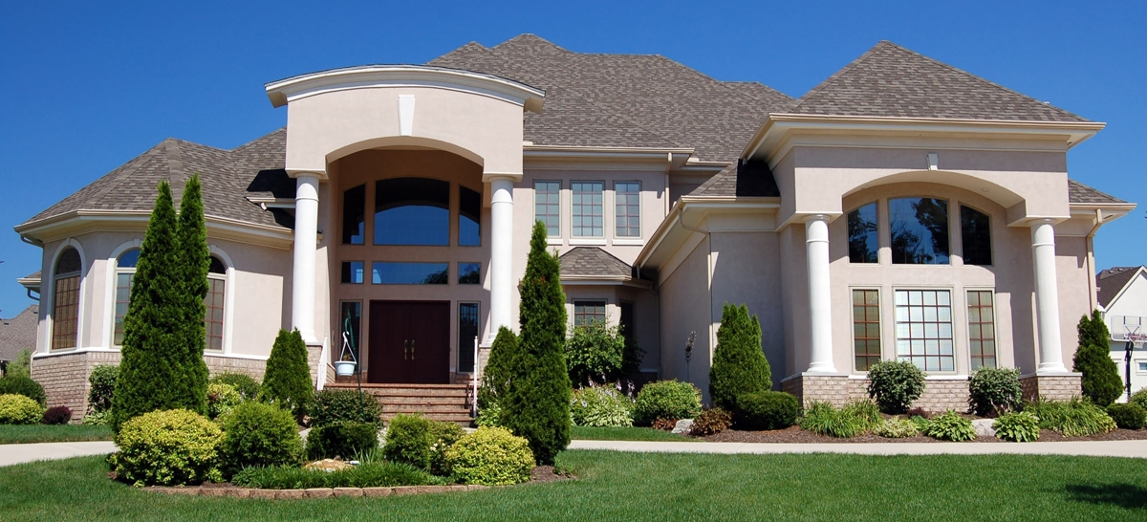
Questions?

Slide 15


Contact Us
Visit us online at www.nyufcu.com to download a Mortgage Loan Application Checklist or the interactive Mortgage Loan Application
Follow us for promotions and new services:
Main Office
NYU Federal Credit Union 726 Broadway, Suite 110 New York, NY 10003 Phone: 212-995-3166
@NYUBanking
NYU Federal Credit Union

